Slide 1
The Model Stacking Approach to Credit Card Debt Prediction
Kaggle Competition: Credit Card Debt Prediction
Donia Ahmed
1/17

Slide 2
01
Understanding the Data
2/17

Slide 3

Introduction
Task: Utilizing a dataset comprising of 10 features to anticipate the credit card balances of 50 individuals via a regression model.
The features are :
Income
Rating
Limit
Cards
Student
Age
Married
Education
Own
Region
3/17

Slide 4
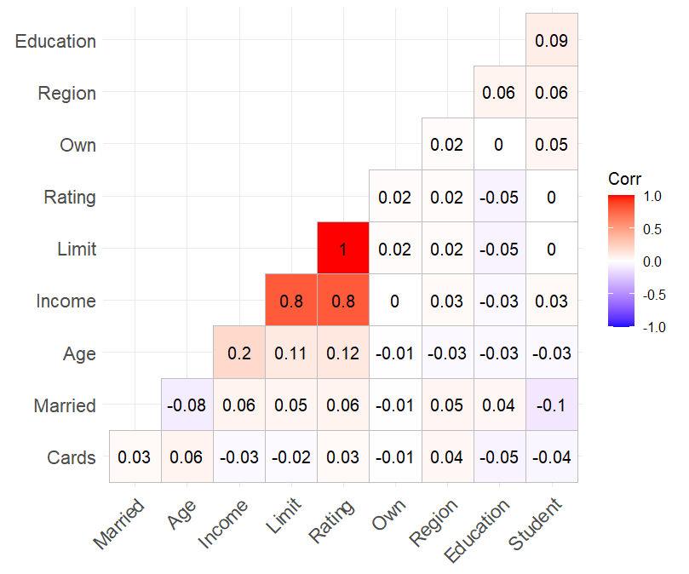
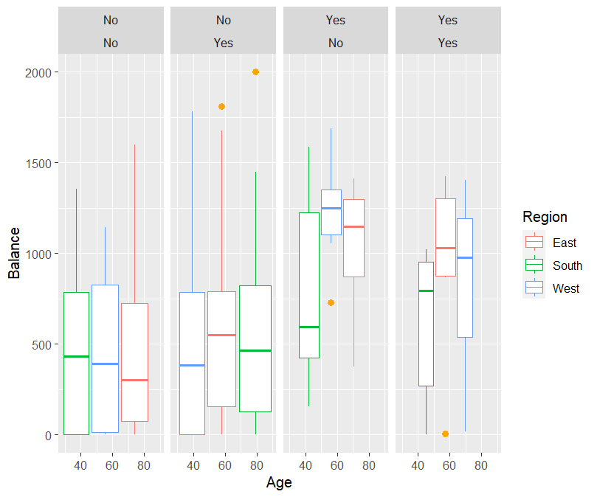
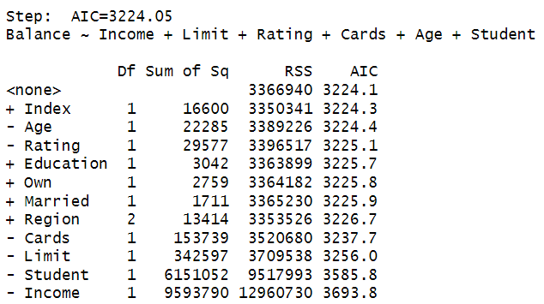
Remarks
Rating, Limit and Income are highly correlated
There are some outliers
Preformed Model Selection:
{Income, Rating, Limit, Cards, Age,
Student}
Introduced noise to the data (adding 1.38 to Balance) in order to perform Box – Cox.
4/17

Slide 5
Methodology
Partitioned the dataset into training and testing sets.
Evaluated several regression models, including MLR, Ridge, LASSO, Elastic Net, Polynomial, MARS, Robust, Bayesian, LOESS, and a combination of logarithmic and square root models.
For each model, R-squared metric was optimized the by selecting a subset of predictors {Income, Rating, Limit, Cards, Age, Student} and exploring interactions among these variables.
Constructed another MLR model incorporating the 10 models as regressors and tested nine additional models, each with distinct interaction terms.
Applied a Box-Cox transformation to satisfy the assumptions.
6/17

Slide 6
02
Introducting Models
5/17

Slide 7
We Fitted Ten Different Models :
Learnt In Class
Generalization
Different Approach
MLR, RIDGE, LASSO, ELASTIC NET, POLYNOMIAL & NON-LINEAR MODEL (ROOT + LOGARITHM)
MARS & Local Polynomial Regression
Bayesian & Robust
7/17

Slide 8
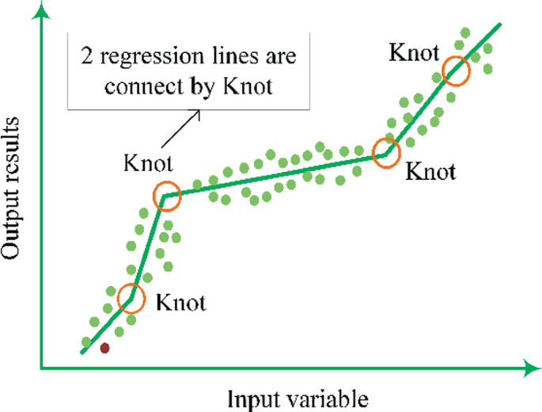
Multivariate Adaptive Regression Splines (MARS)
An extension of piecewise linear regression into higher dimensions. It segments the predictor space and fits a linear model within each segment, offering flexibility to capture complex relationships without rigid assumptions about the relationship's form.
The modelling process involves a forward pass to add basis functions
and a backward pass to simplify the model (removing unnecessary
basis functions and adjusting the knot positions.).
The selection of variables and values for knots of the hinge functions is automatic.
8/17

Slide 9
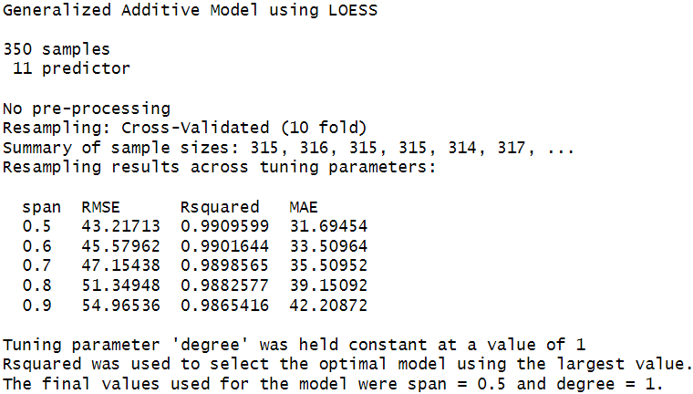
Local Polynomial Regression
Most common methods are :
LOESS (locally estimated scatterplot smoothing)
LOWESS (locally weighted scatterplot smoothing)
LOESS relies on the concept that a low-order polynomial can effectively capture the behaviour of a function within a neighborhood and can be simply fitted.
The local polynomials fitted to each subset of the data typically have either a first or second-degree, meaning they are either locally linear (in a straight line sense) or locally quadratic.
LOESS is less sensitive to outliers and captures nonlinear relationships by fitting locally adaptive models.
Generalization of polynomial regression.
8/17

Slide 10
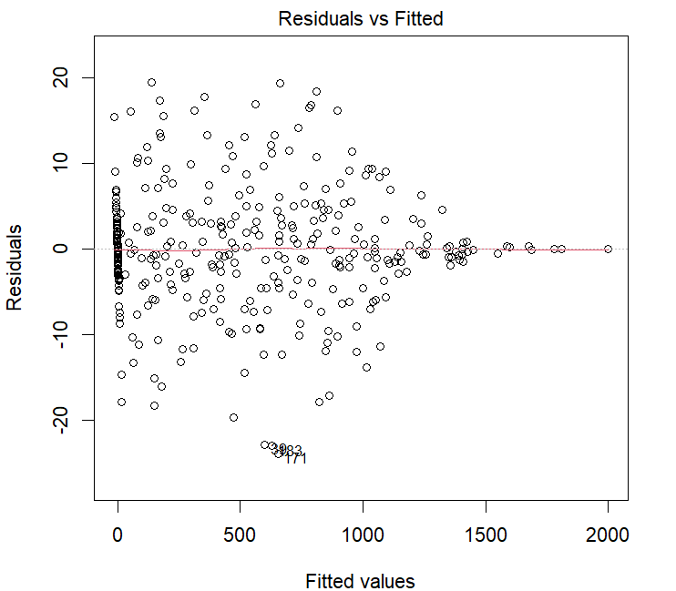
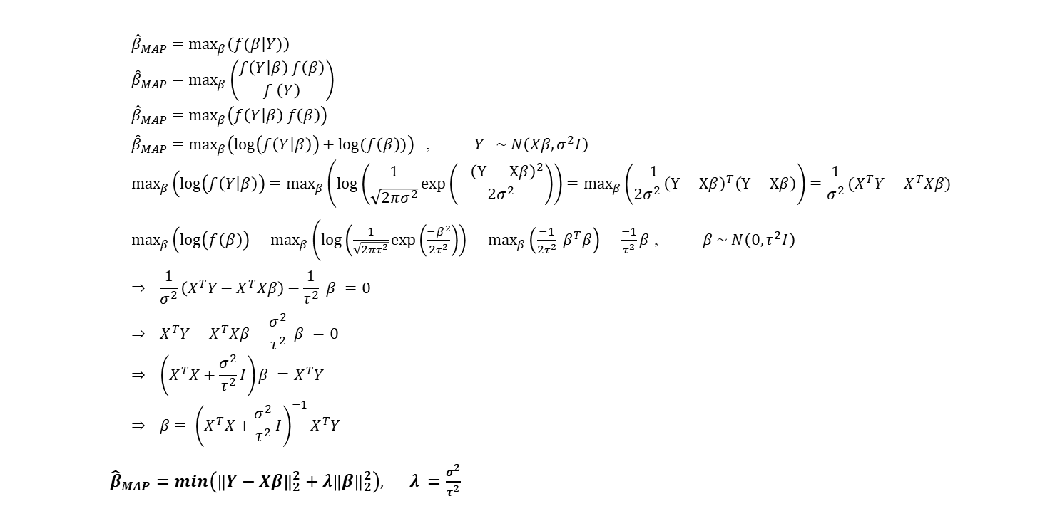
Bayesian Regression
What is Bayesian Regression ?
A statistical approach to regression analysis incorporating Bayes Theorem where the parameters are treated as random variables with probability distributions (obtained by calculating the posterior distribution of parameters given the data and prior beliefs).
$${\hat{β}}_{MAP}=\max_{β}\left(f(\left.β\right|Y)\right)$$
$${\hat{β}}_{MAP}=\max_{β}\left(\frac{f\left(\left.Y\right|β\right) f\left(β\right)}{f \left(Y\right)}\right)$$
$${\hat{β}}_{MAP}=\max_{β}\left(f\left(\left.Y\right|β\right) f\left(β\right)\right)$$
${\hat{β}}_{MAP}=\max_{β}\left(\log\left(f\left(\left.Y\right|β\right)\right)+log⁡(f\left(β\right))\right)$ , $Y \sim N\left(Xβ,σ^{2}I\right)$
$$\max_{β}\left(\log\left(f\left(\left.Y\right|β\right)\right)\right.=\max_{β}\left(\log\left(\frac{1}{\sqrt{2πσ^{2}}}\exp\left(\frac{−{\left(Y −Xβ\right)}^{2}}{2σ^{2}}\right)\right)\right.=\max_{β}\left(\frac{−1}{2σ^{2}}{\left(Y−Xβ\right)}^{T}\left(Y−Xβ\right)\right)=\frac{1}{σ^{2}}(X^{T}Y−X^{T}Xβ)$$
$\max_{β}\left(\log\left(f\left(β\right)\right)\right.=\max_{β}\left(\log\left(\frac{1}{\sqrt{2πτ^{2}}}\exp\left(\frac{−β^{2}}{2τ^{2}}\right)\right)\right.=\max_{β}\left(\frac{−1}{2τ^{2}}{ β}^{T}β\right)=\frac{−1}{τ^{2}}β$ , $β \sim N\left(0,τ^{2}I\right)$
$$⇒ {\frac{1}{σ^{2}}\left(X^{T}Y−X^{T}Xβ\right)−\frac{1}{τ^{2}} β =0}$$
$$⇒ {X^{T}Y−X^{T}Xβ−\frac{σ^{2}}{τ^{2}} β =0}$$
$$⇒ \left(X^{T}X+\frac{σ^{2}}{τ^{2}}I\right)β =X^{T}Y$$
$$⇒ {β= {\left(X^{T}X+\frac{σ^{2}}{τ^{2}}I\right)}^{−1}X^{T}Y }$$
${\hat{β}}_{MAP}=min\left({\left\|Y−Xβ\right\|}_{2}^{2}+λ{\left\|β\right\|}_{2}^{2}\right), λ =\frac{σ^{2}}{τ^{2}}$
Why Bayesian Regression?
Handles multicollinearity by including prior beliefs about the parameters and shrinking them towards zero
Outliers have less influence on the estimates compared to OLS because the posterior distribution is influenced by both the data and the prior beliefs.
Can incorporate heteroscedasticity by modelling the variance as a function of the predictors.
MLR Model
Notice that the estimate using Gaussian prior is similar to L2 regularization in OLS
10/17

Slide 11
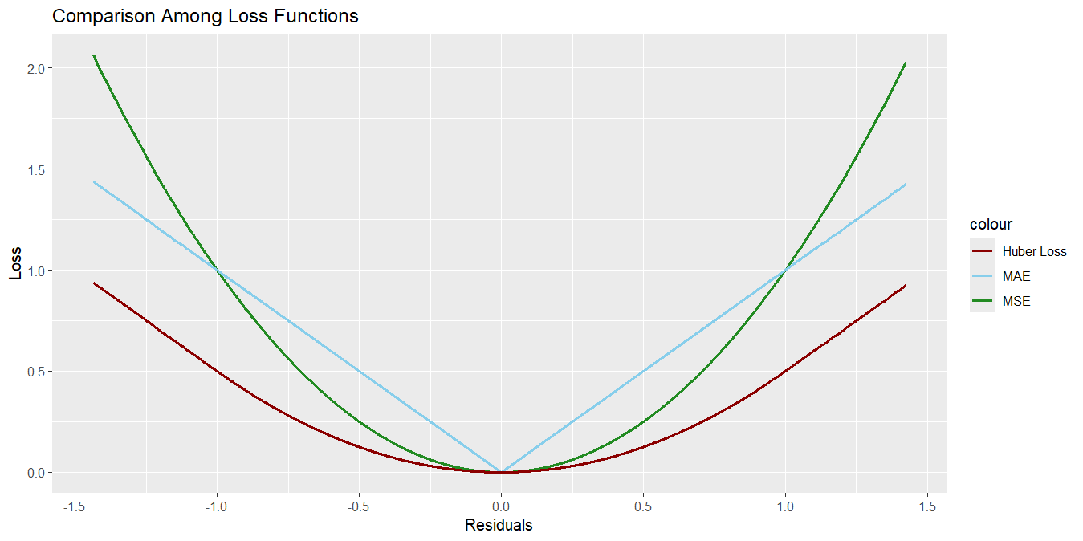
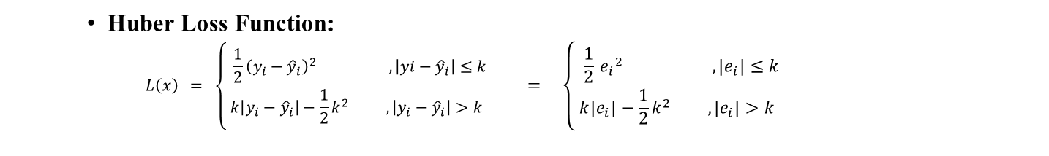
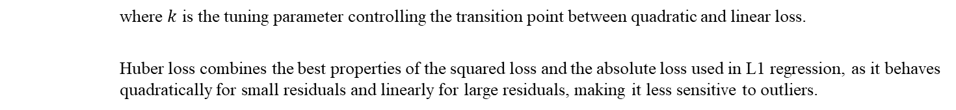
Robust Regression
What is Robust Regression ?
It is a statistical method used to model the relationship between a response variable and one or more independent variables in the presence of outliers, heteroscedasticity and other violations of classical regression assumptions.
It uses alternative loss functions to estimate the regression parameters, which are less affected by outliers compared to the squared error loss function used in OLS regression.
Huber Loss Function:
$$L\left(x\right) = \left\{\begin{matrix} \frac{1}{2}{\left(y_{i}−{\hat{y}}_{i}\right)}^{2} , \left|yⅈ−{\hat{y}}_{i}\right|≤k \\ k\left|y_{i}−{\hat{y}}_{i}\right|−\frac{1}{2}k^{2} ,\left|y_{i}−{\hat{y}}_{i}\right|>k\end{matrix}\right. = \left\{\begin{matrix} \frac{1}{2} {e_{i}}^{2} , \left|e_{i}\right|≤k \\ k\left|e_{i}\right|−\frac{1}{2}k^{2} ,\left|e_{i}\right|>k\end{matrix}\right.$$
where $k$ is the tuning parameter controlling the transition point between quadratic and linear loss.
Huber loss combines the best properties of the squared loss and the absolute loss used in L1 regression, as it behaves quadratically for small residuals and linearly for large residuals, making it less sensitive to outliers.
11/17

Slide 12

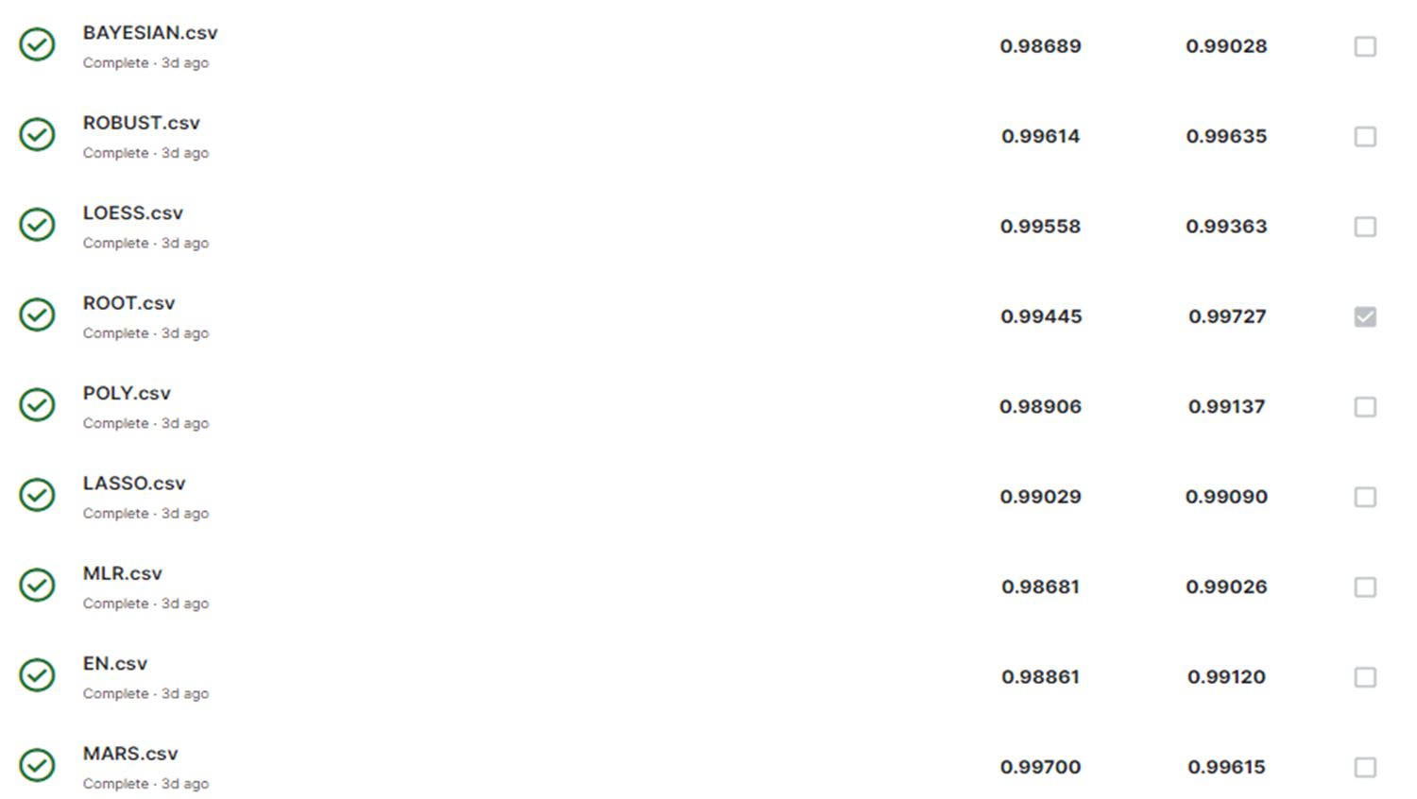
Ridge was not submitted
Ridge was not submitted because it performed poorly compared to other models (0.94) although it was considered in the final model.
because it preformed poorly compared to other models (0.94) although it was considered in the final model.

Slide 13
03
Final Model
13/17

Slide 14
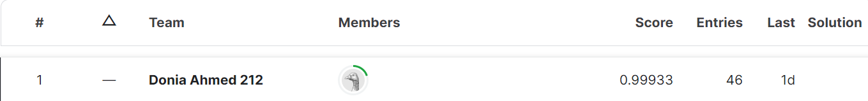
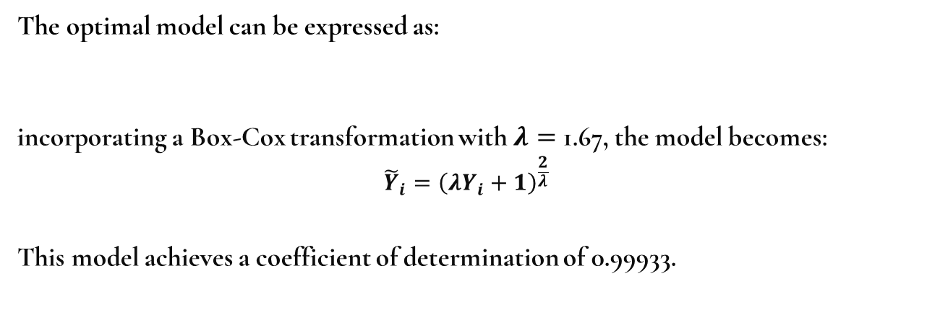
Root & Box – Cox Transformations on Stacked Model
The optimal model can be expressed as:
incorporating a Box-Cox transformation with $λ=$ 1.67, the model becomes:
$${\tilde{Y}}_{i}={\left(λY_{i}+1\right)}^{\frac{2}{λ}}$$
This model achieves a coefficient of determination of 0.99933.
$\sqrt{Y}$ = $\sqrt{Root}∗\sqrt{Poly∗MLR} +\sqrt{MARS}∗\sqrt{LASSO}∗\sqrt{ROBUST}∗\sqrt{LOESS}+\sqrt{Ridge}∗\sqrt{EN} ∗\sqrt{B}$
14/17

Slide 15
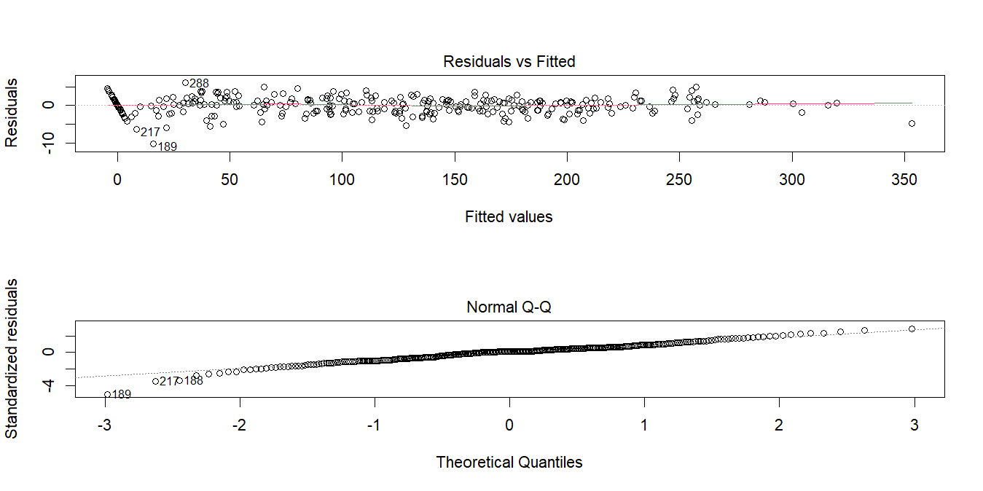
ASSUMPTIONS
15/17

Slide 16
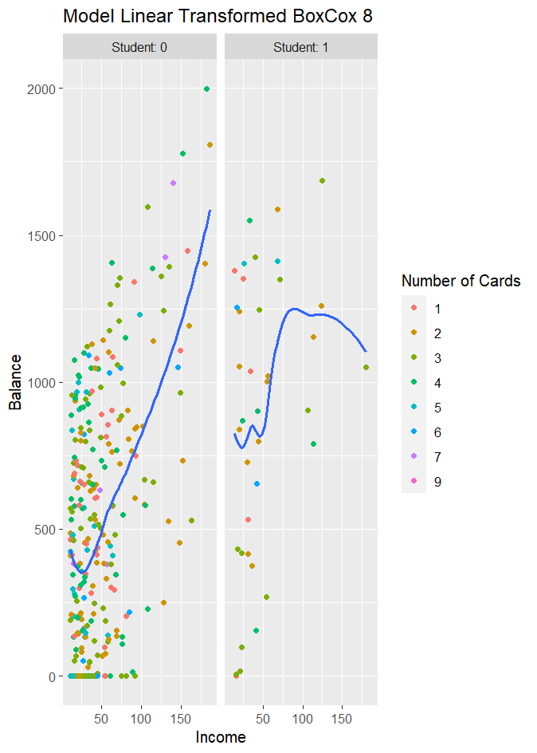
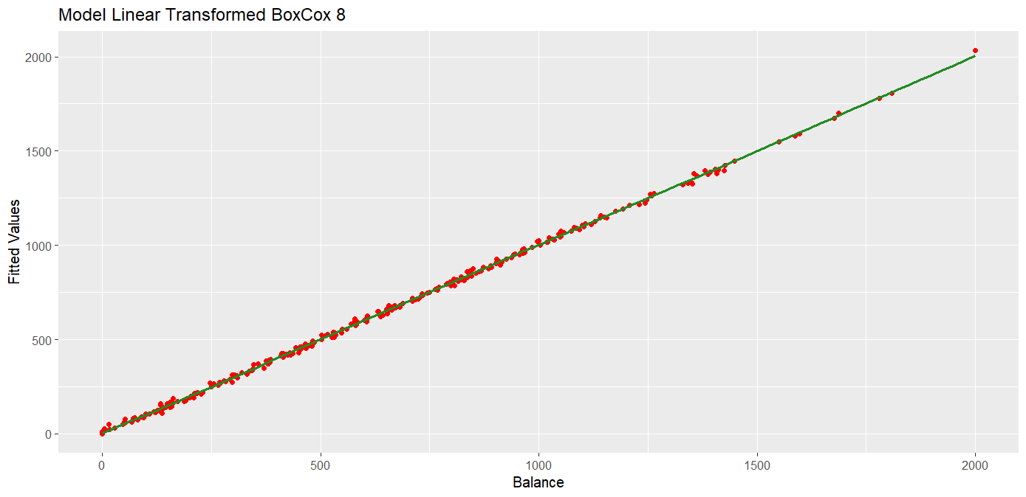
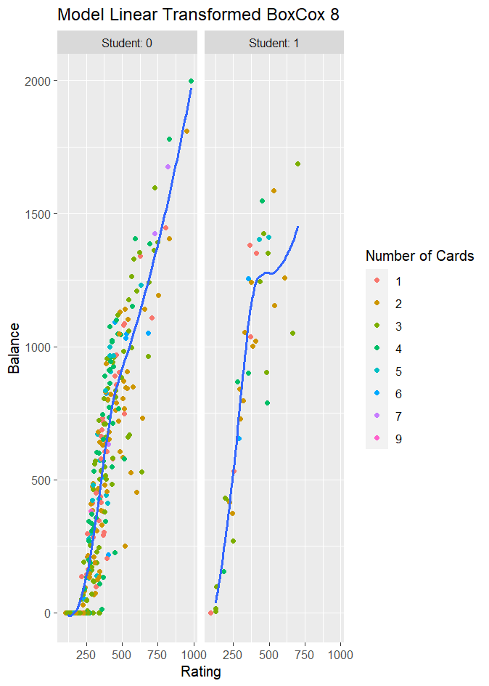
PREDICTIONS
Index | 1 | 2 | 3 | 4 | 5 | 6 | 7 | 8 | 9 | 10
Balance | 598.2171 | 0 | 972.9913 | 2.13623 | 199.727 | 1309.052 | 632.0019 | 0 | 1196.384 | 369.4248
Index | 11 | 12 | 13 | 14 | 15 | 16 | 17 | 18 | 19 | 20
Balance | 12.18709 | 0 | 0 | 2.436958 | 895.251 | 887.8639 | 529.3173 | 530.3496 | 893.8861 | 1303.073
Index | 21 | 22 | 23 | 24 | 25 | 26 | 27 | 28 | 29 | 30
Balance | 1099.289 | 686.425 | 533.3019 | 296.3443 | 6.49523 | 0.8919 | 111.722 | 1.674917 | 1574.744 | 0
Index | 31 | 32 | 33 | 34 | 35 | 36 | 37 | 38 | 39 | 40
Balance | 511.741 | 1076.40 | 939.7199 | 588.590 | 3.911731 | 323.2493 | 1004.5 | 0.8919 | 0.8919 | 1224.377
Index | 41 | 42 | 43 | 44 | 45 | 46 | 47 | 48 | 49 | 50
Balance | 380.469 | 2.03849 | 424.1252 | 719.3626 | 338.8139 | 178.4494 | 316.0381 | 0.831699 | 1.983154 | 639.8723
16/17

Slide 17
THANK YOU!
17/17

